Slide 1
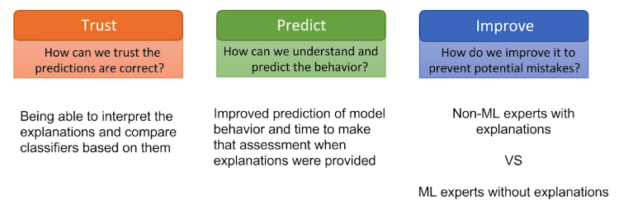

Slide 2
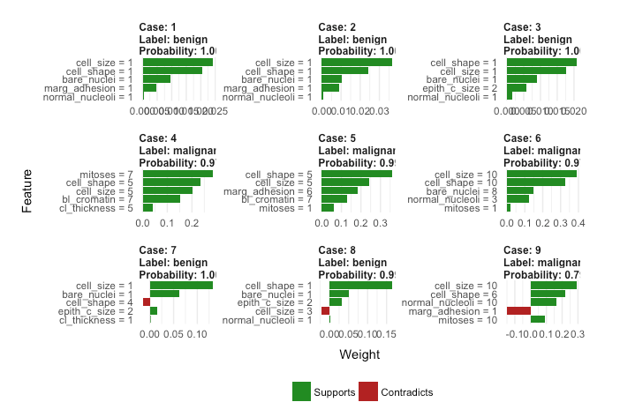
lead to this feature importance plots (not the same for each case!). The green bars mean that the feature supports predicted label, and the red bars contradict it. Let’s have a look at the correctly predicted labels:
Smaller and more regular cells with low values of bare nuclei (bare_nuclei):correctly indicate benign cells,
whereas big, irregular cells with higher values of clump thickness (cl_thickness) support malignant label. It all makes sense.

Slide 3
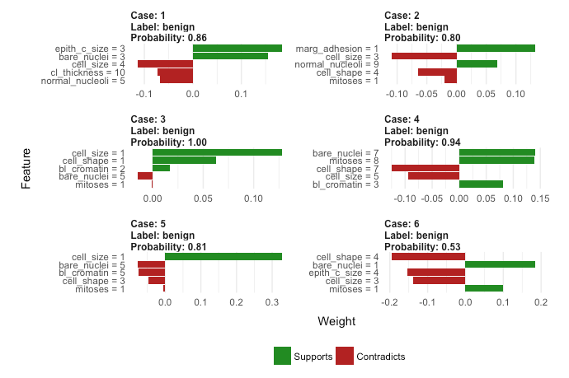
What about the misclasified labels?
All the wrong cases were predicted to be benign while they were malignant, why?
It looks like they were mainly small and quite regular cells, although some malignant characteristics were still present (e.g. higher values of bare nuclei and clump thickness).
What a great improvement of our understanding of how the ‘black box’ model works and why it makes mistakes. Even though it doesn’t produce ‘fixed’ feature importance plots (i.e. a general, not case-to-case view of which variables are most informative when making a prediction), it allows you to make a good educated guess of which features matter.

Slide 4
use the LIME explainer class to predict the top 5 most important features that influence in both predicted classes.
import lime
LIME explainer class to predict the top 5 most important features that influence in both predicted classes.
import lime.lime_tabular
h2o_drf_wrapper = h2o_predict_proba_wrapper(aml.leader,feature_names)
explainer = lime.lime_tabular.LimeTabularExplainer(train ,class_names=class_names, feature_names = feature_names,
categorical_features=categorical_features, categorical_names=categorical_names,kernel_width=3, verbose=True)
i = 27
exp = explainer.explain_instance(test[i], h2o_drf_wrapper.predict_proba, num_features=5)

